Slide 1
Consolidation of the JAIN SIP Applet Phone
Muswera Walter
Supervisor: Prof Alfredo Terzoli

Slide 2
Overview
Convergence Research Group - mainly concerned with current trends in the move towards converged service platforms for NGN and the Internet
Research covers areas such as service orchestration, policy frameworks for service development, development of toolkits for services such as IPTV, LBS and VoD using open standards.
These projects rely heavily on client software for proper testing and evaluation.

Slide 3
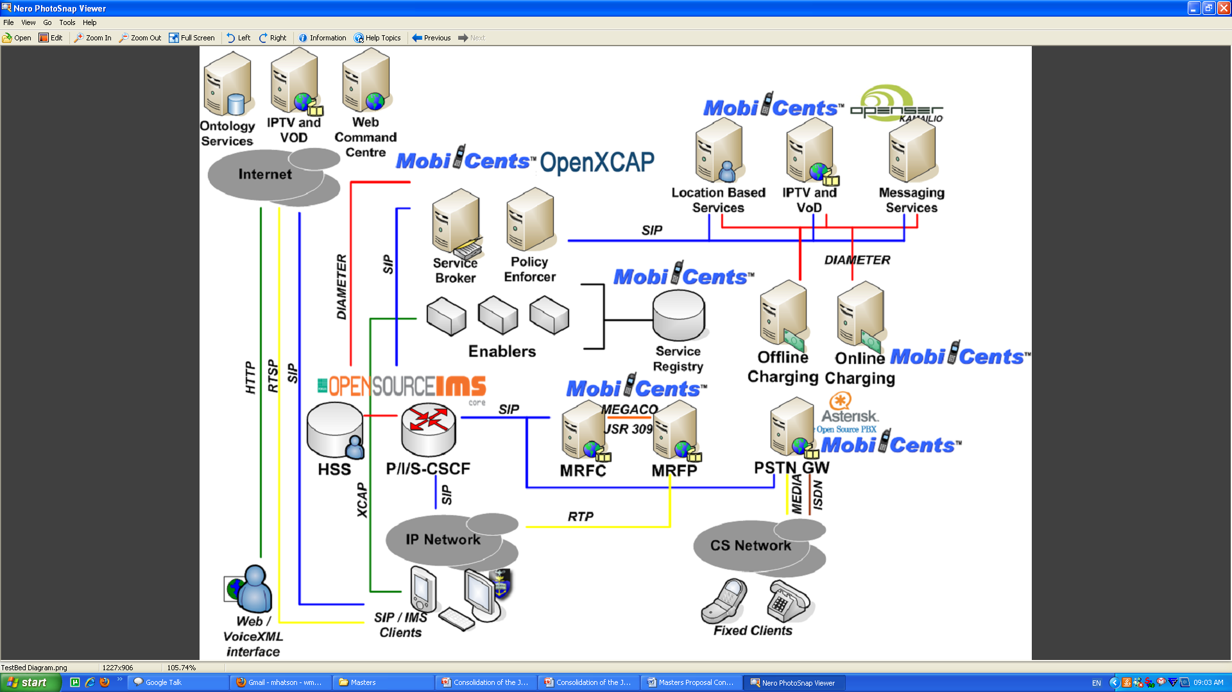
Convergence Testbed

Slide 4
Problem Statement
Several free and open source clients are currently in use
Twinkle
Ekiga
ExpressTalk
Linphone
SIP Communicator
no single client provides researchers with all the required features - making testing difficult

Slide 5
Problem Statement (1)
JSAP is an open source project which is currently being managed by one of the team members.
It possesses some of the basic features (voice and text IM) which are required, but is in need of several extensions in order to realize full consolidation

Slide 6
JSAP Architecture

Slide 7
The JAIN SIP Applet Phone Interface

Slide 8
Problem Statement (2)
Video implementation in the JSAP is not fully functional and requires attention.
Video capture - an issue in Ubuntu with JMF
Current media API (JMF) used in the JSAP lacks support for some of the major codecs e.g. MPEG 1
No XCAP support in JSAP

Slide 9
Problem Statement (3)
Bugs have also been identified in the JSAP which require attention.
Server responses have not been handled thus resulting in undesired client behavior.
Client keeps requesting the user for details after registration has expired.
User credentials need secure storage.
Duration for which user registration credentials are valid (session vs application requests their removal)

Slide 10
Aims of the Research
Investigate whether there are alternate media APIs available to replace JMF
Addition of new SIP features into the client through SIP Extensions
Inclusion of XCAP protocol into the client
Code clean up

Slide 11
Aims of the Research (1)
Provide a unified client for application testing to researchers in the Convergence Group
Provide a cross platform client that uses open standards

Slide 12
Approach
Test functionality and support of new media APIs and then integrating the most appropriate into the client
Gather a comprehensive list of requirements from Convergence Group Researchers and incrementally add functionality to the client.
Test the client for compatibility with different SIP servers (Kamailio, Asterisk, Mobicents etc).

Slide 13
Current Work
Investigating alternative open source media APIs to the JMF
Among the projects being investigated there are a variety of implementations building on top of JMF
FMJ is a new open source project which was started to implement and extend JMF
+ FMJ is API compatible with latest JMF - one can use existing JMF codes and run apps.
several areas of the project under development - need to find workarounds existing JMF codes do not work

Slide 14
Current Work (1)
Gstreamer
framework for creating streaming media applications
based on plugins that provide the various codecs and other functionality
plugins can be linked and arranged in a pipeline -makes it possible to write any type of streaming multimedia application

Slide 15
Current Work (2)
GStreamer-Java
a java interface to the gstreamer framework
Uses jna to access gstreamer functionality
Still under development
gstreamer itself, and these java bindings are portable across operating systems

Slide 16
Current Work (2)
FFMPEG
JFFMPEG

Slide 17
Questions ?????

